Slide 1

CARC103 – Computer Architecture
Kent Institute Australia Pty. Ltd.
ABN 49 003 577 302 CRICOS Code: 00161E RTO Code: 90458 TEQSA Provider Number: PRV12051

Slide 2
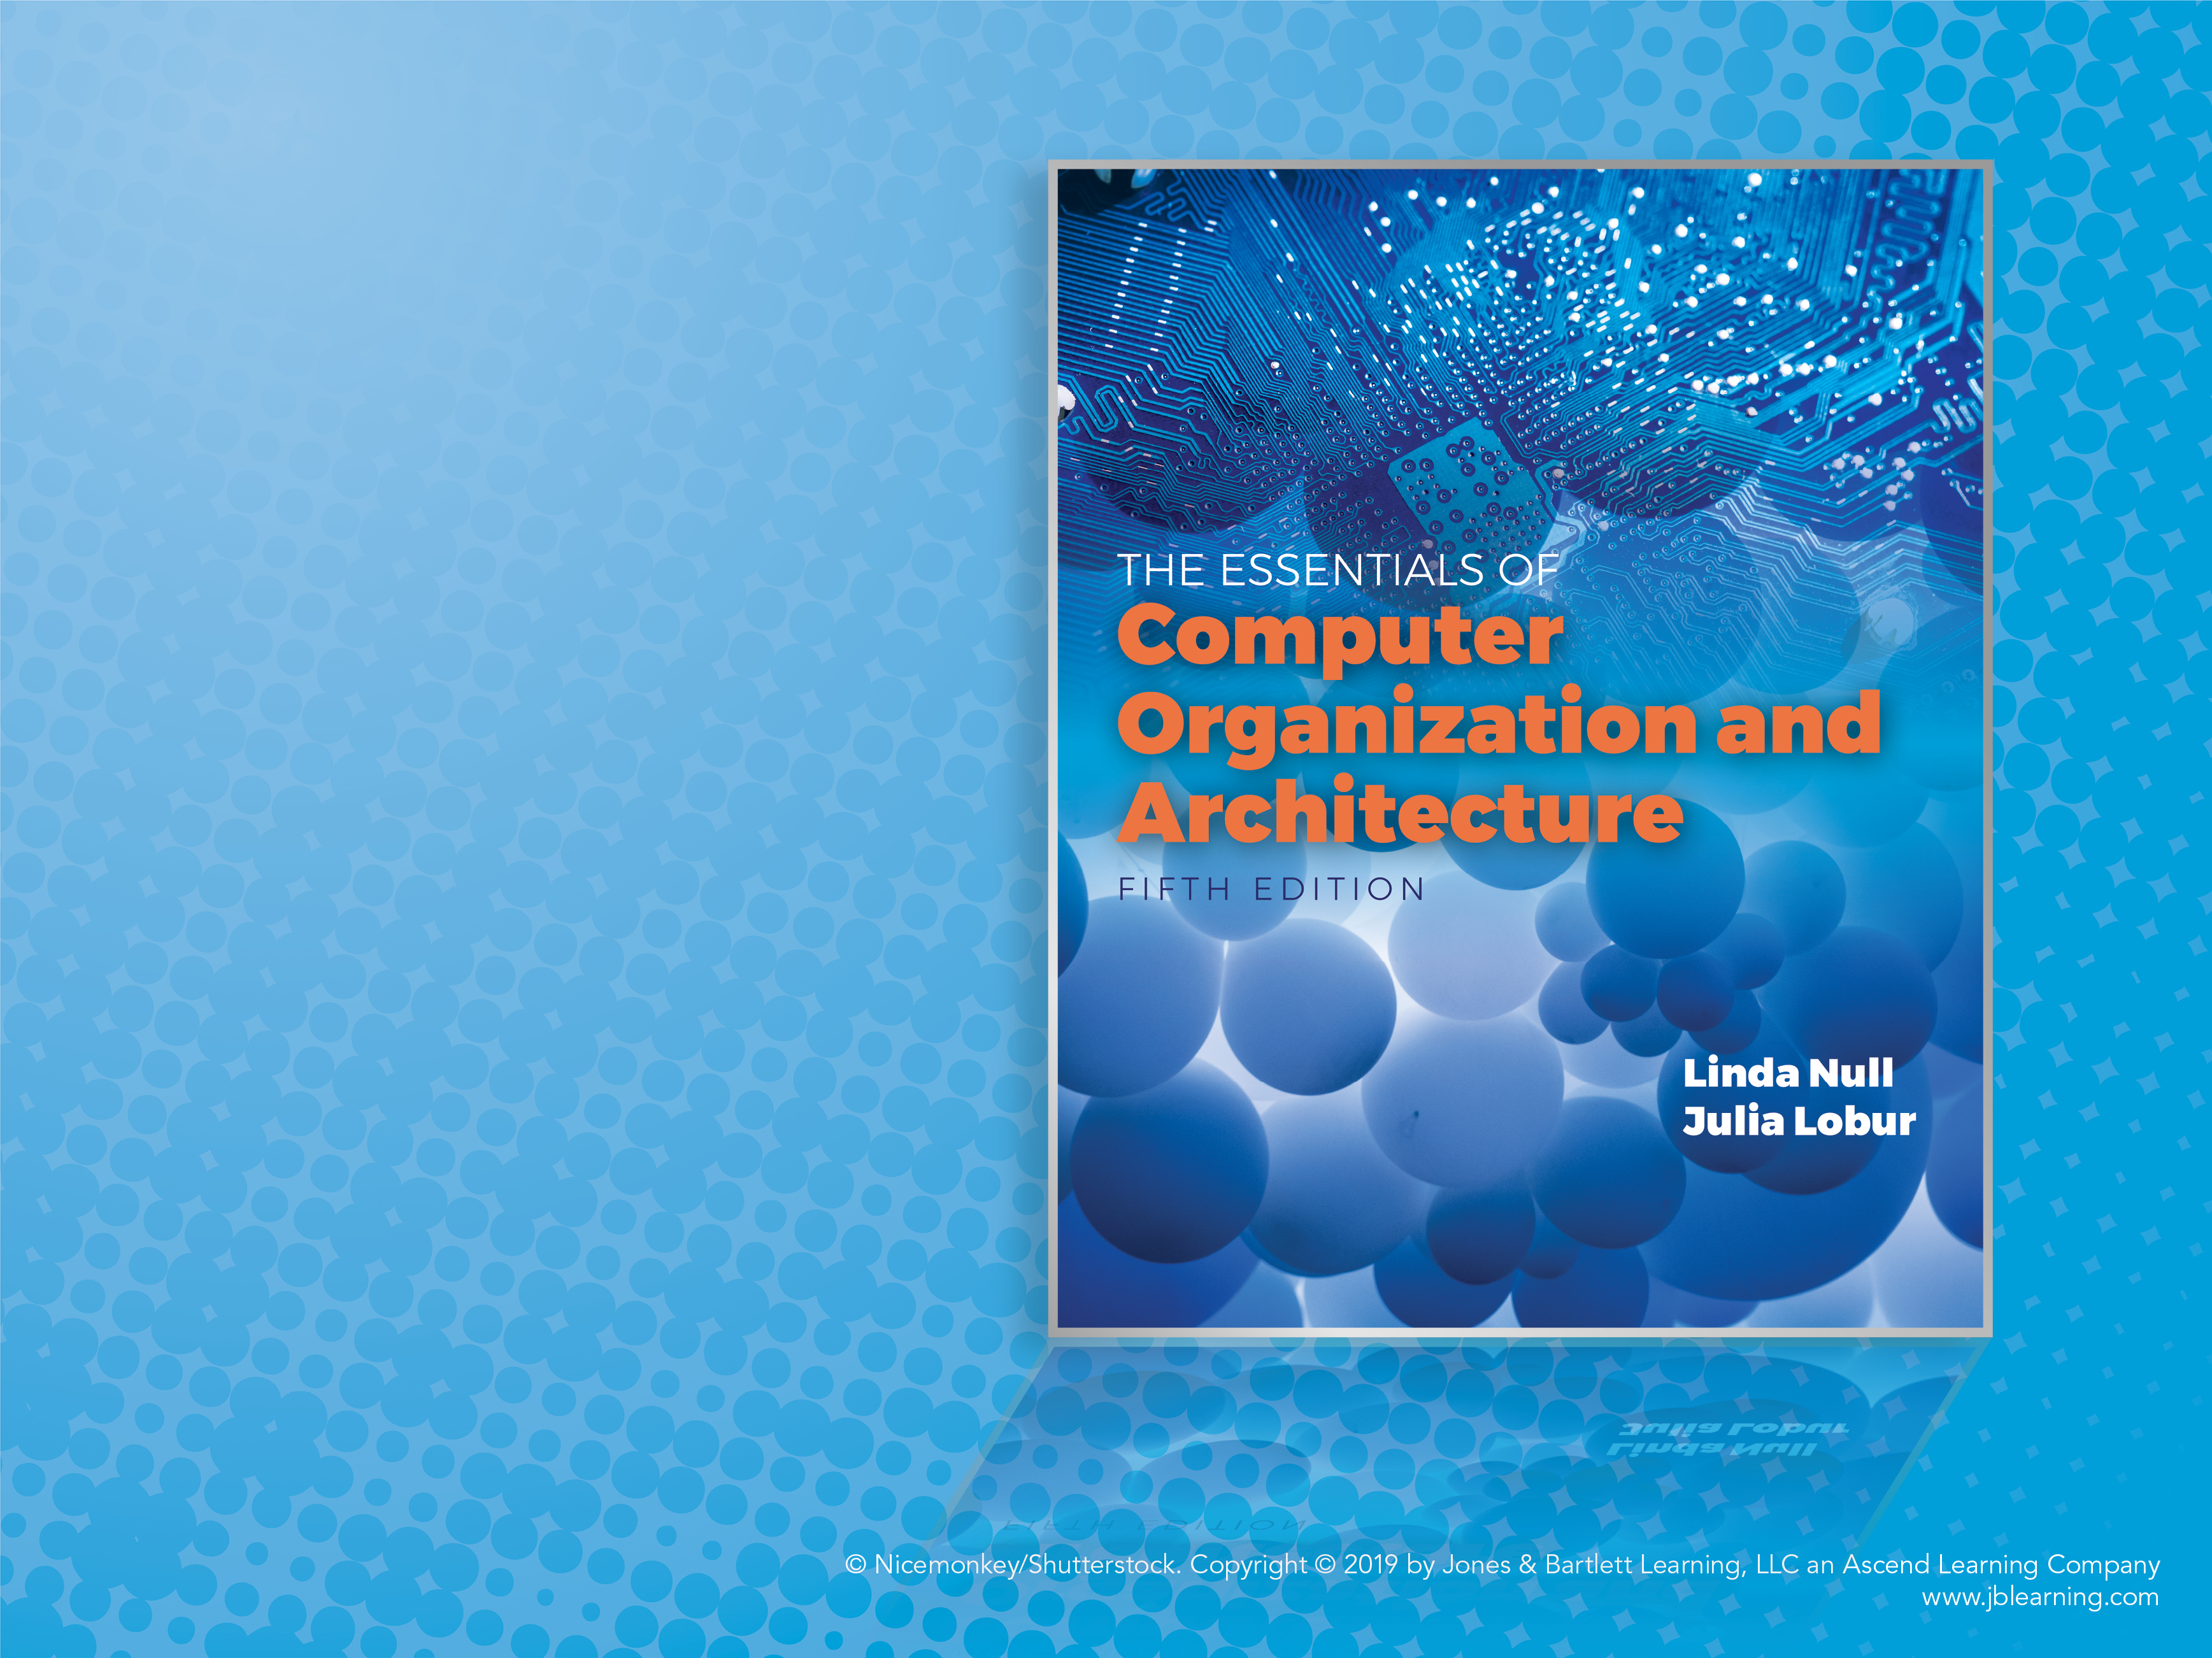
Chapter 2 Part 2
Data
Representation
in Computer
Systems

Slide 3
Objectives
Understand the fundamentals of numerical data representation and manipulation in digital computers.
Master the skill of converting between various radix systems.
Understand how errors can occur in computations because of overflow and truncation.

Slide 4
Objectives
Understand the fundamental concepts of floating-point representation.
Gain familiarity with the most popular character codes.

Slide 5
Data Representation
Binary numbers can be stored in two different formats:
Unsigned numbers (coved in part 1 of this chapter)
Signed numbers (Today chapter)
Binary representation
Unsigned
Signed
^{Integer Number}
^{Floating Point Number}
Signed magnitude
One's complement
Two's complement
IEEE-754 Format

Slide 6
Signed Integer Representation
The conversions we have so far presented have involved only unsigned numbers.
To represent signed integers, computer systems allocate the high-order bit to indicate the sign of a number.
The high-order bit is the leftmost bit. It is also called the most significant bit.
0 is used to indicate a positive number; 1 indicates a negative number.
The remaining bits contain the value of the number (but this can be interpreted different ways).

Slide 7
Signed Integer Representation
There are three ways in which signed binary integers may be expressed:
Signed magnitude
One’s complement
Two’s complement
In an 8-bit word, signed magnitude representation places the absolute value of the number in the 7 bits to the right of the sign bit.

Slide 8
Signed Integer Representation
For example, in 8-bit signed magnitude representation:
+3 is: 00000011
–3 is: 10000011
Computers perform arithmetic operations on signed magnitude numbers in much the same way as humans carry out pencil and paper arithmetic.
Humans often ignore the signs of the operands while performing a calculation, applying the appropriate sign after the calculation is complete.

Slide 9
Signed Integer Representation
Binary addition is as easy as it gets. You need to know only four rules:
0 + 0 = 0 0 + 1 = 1
1 + 0 = 1 1 + 1 = 10
The simplicity of this system makes it possible for digital circuits to carry out arithmetic operations.

Slide 10
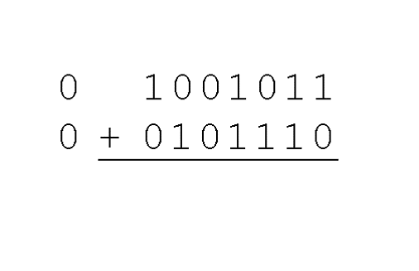
Signed Integer Representation
Let’s see how the addition rules work with signed magnitude numbers . . .
Example (1):
Using signed magnitude binary arithmetic, find the sum of 75 and 46.
First, convert 75 and 46 to binary, and arrange as a sum, but separate the (positive) sign bits from the magnitude bits.

Slide 11
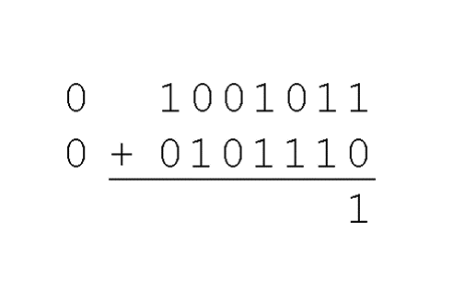
Signed Integer Representation
Example (1):
Using signed magnitude binary arithmetic, find the sum of 75 and 46.
Just as in decimal arithmetic, we find the sum starting with the rightmost bit and work left.

Slide 12
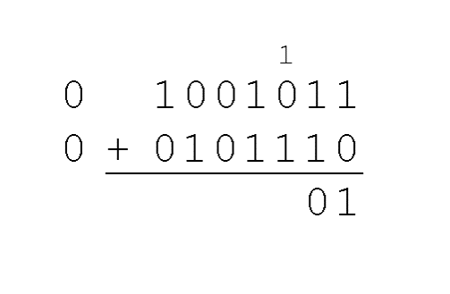
Signed Integer Representation
Example (1):
Using signed magnitude binary arithmetic, find the sum of 75 and 46.
In the second bit, we have a carry, so we note it above the third bit.

Slide 13
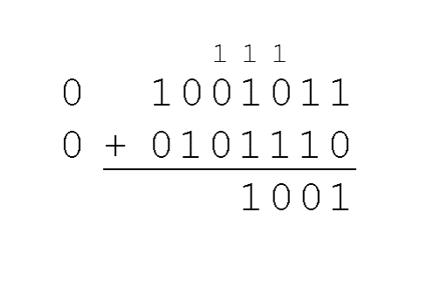
Signed Integer Representation
Example (1):
Using signed magnitude binary arithmetic, find the sum of 75 and 46.
The third and fourth bits also give us carries.

Slide 14
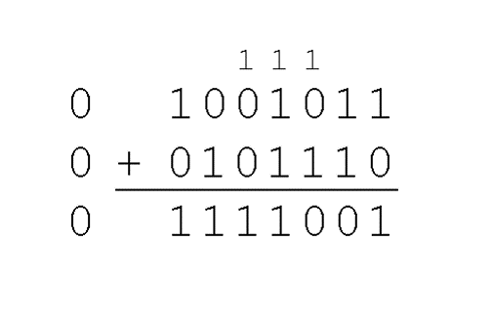
Signed Integer Representation
Example (1):
Using signed magnitude binary arithmetic, find the sum of 75 and 46.
Once we have worked our way through all eight bits, we are done.
In this example, we were careful to pick two values whose sum would fit into seven bits. If that is not the case, we have a problem.

Slide 15
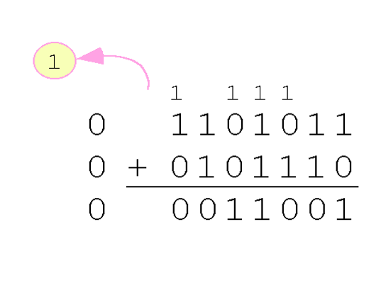
Signed Integer Representation
Example (2):
Using signed magnitude binary arithmetic, find the sum of 107 and 46.
We see that the carry from the seventh bit overflows and is discarded, giving us the erroneous result: 107 + 46 = 25.

Slide 16
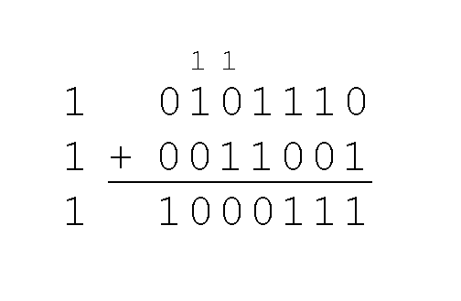
Signed Integer Representation
The signs in signed magnitude representation work just like the signs in pencil and paper arithmetic.
Example: Using signed magnitude binary arithmetic, find the sum of –46 and –25.
Because the signs are the same, all we do is add the numbers and supply the negative sign when we are done.

Slide 17
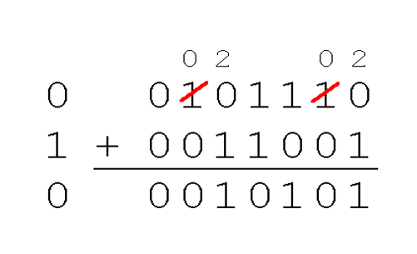
Signed Integer Representation
Mixed sign addition (or subtraction) is done the same way.
Example: Using signed magnitude binary arithmetic, find the sum of 46 and –25.
The sign of the result gets the sign of the number that is larger.
Note the “borrows” from the second and sixth bits.

Slide 18
Complement Systems
Signed magnitude representation is easy for people to understand, but it requires complicated computer hardware.
Another disadvantage of signed magnitude is that it allows two different representations for zero: positive zero and negative zero.
For these reasons (among others) computers systems employ complement systems for numeric value representation.

Slide 19
Complement Systems – One’s Complement
In complement systems, negative values are represented by some difference between a number and its base.
The diminished radix complement of a non-zero number N in base r with d digits is (r^{d} – 1) – N
In the binary system, this gives us one’s complement. It amounts to little more than flipping the bits of a binary number.

Slide 20
Complement Systems – One’s Complement
For example, using 8-bit one’s complement representation:
+3 is: 00000011
–3 is: 11111100
In one’s complement representation, as with signed magnitude, negative values are indicated by a 1 in the high order bit.
Complement systems are useful because they eliminate the need for subtraction. The difference of two values is found by adding the minuend to the complement of the subtrahend.

Slide 21
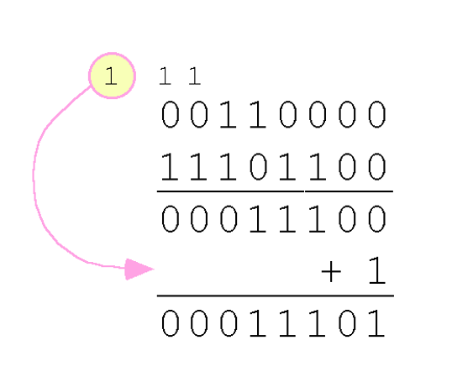
Complement Systems – One’s Complement
With one’s complement addition, the carry bit is “carried around” and added to the sum.
Example: Using one’s complement binary arithmetic, find the sum of 48 and –19.
We note that 19 in binary is 00010011,
so –19 in one’s complement is: 11101100.

Slide 22
Complement Systems – Two’s Complement
Although the “end carry around” adds some complexity, one’s complement is simpler to implement than signed magnitude.
But it still has the disadvantage of having two different representations for zero: positive zero and negative zero.
Two’s complement solves this problem.
Two’s complement is the radix complement of the binary numbering system; the radix complement of a non-zero number N in base r with d digits is r^{d} – N.

Slide 23
Complement Systems – Two’s Complement
To express a value in two’s complement representation:
If the number is positive, just convert it to binary and you’re done.
If the number is negative, find the one’s complement of the number and then add 1.
Example:
In 8-bit binary, 3 is: 00000011
–3 using one’s complement representation is: 11111100
Adding 1 gives us –3 in two’s complement form: 11111101.

Slide 24
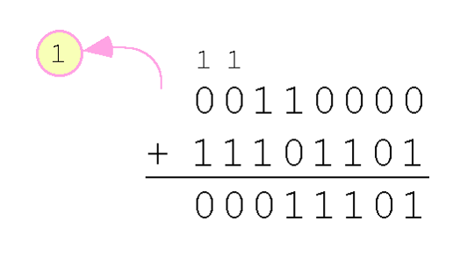
Complement Systems – Two’s Complement
With two’s complement arithmetic, all we do is add our two binary numbers. Just discard any carries emitting from the high order bit
Example: Using one’s complement binary arithmetic, find the sum of 48 and –19.
We note that 19 in binary is: 00010011,
so –19 using one’s complement is: 11101100,
and –19 using two’s complement is: 11101101.

Slide 25
Data Representation - Signed Integer Representation
Lets compare our representations:
Decimal | Binary (for absolute value | Signed Magnitude | One’s Complement | Two’s Complement
2 | 00000010 | 00000010 | 00000010 | 00000010
-2 | 00000010 | 10000010 | 11111101 | 11111110
100 | 01100100 | 01100100 | 01100100 | 01100100
-100 | 01100100 | 11100100 | 10011011 | 10011100

Slide 26
Two’s Complement – Detecting Overflow Condition
When we use any finite number of bits to represent a number, we always run the risk of the result of our calculations becoming too large or too small to be stored in the computer.
While we can’t always prevent overflow, we can always detect overflow.
In complement arithmetic, an overflow condition is easy to detect.

Slide 27
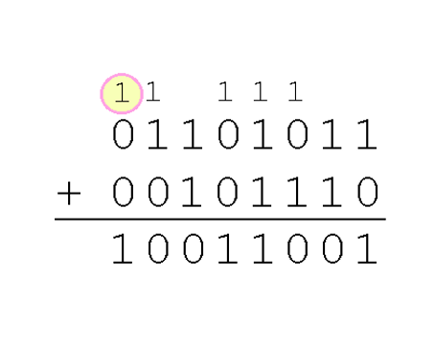
Two’s Complement – Detecting Overflow Condition
Example:
Using two’s complement binary arithmetic, find the sum of 107 and 46.
We see that the nonzero carry from the seventh bit overflows into the sign bit, giving us the erroneous result: 107 + 46 = –103.
But overflow into the sign bit does not always mean that we have an error.

Slide 28
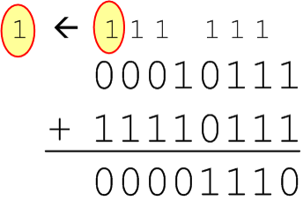
Two’s Complement – Detecting Overflow Condition
Example:
Using two’s complement binary arithmetic, find the sum of 23 and –9.
We see that there is carry into the sign bit and carry out. The final result is correct: 23 + (–9) = 14.
Rule for detecting signed two’s complement overflow: When the “carry in” and the “carry out” of the sign bit differ, overflow has occurred. If the carry into the sign bit equals the carry out of the sign bit, no overflow has occurred.

Slide 29
Unsigned VS Signed Numbers
Signed and unsigned numbers are both useful.
For example, memory addresses are always unsigned.
Using the same number of bits, unsigned integers can express twice as many “positive” values as signed numbers.
Trouble arises if an unsigned value “wraps around.”
In four bits: 1111 + 1 = 0000.
Good programmers stay alert for this kind of problem.

Slide 30
Computers, Arithmetic, and Booth’s Algorithm
Research into finding better arithmetic algorithms has continued for over 50 years.
One of the many interesting products of this work is Booth’s algorithm.
In most cases, Booth’s algorithm carries out multiplication faster and more accurately than pencil-and-paper methods.
The general idea is to replace arithmetic operations with bit shifting to the extent possible.

Slide 31
Computers, Arithmetic, and Booth’s Algorithm
0011
x 0110
+ 0000 (shift)
- 0011 (subtract)
+ 0000 (shift)
+ 0011 (add) .
00010010
In Booth’s algorithm:
If the current multiplier bit is 1 and the preceding bit was 0, subtract the multiplicand from the product
If the current multiplier bit is 0 and the preceding bit was 1, we add the multiplicand to the product
If we have a 00 or 11 pair, we simply shift.
Assume a mythical “0” starting bit
Shift after each step
We see that 3 × 6 = 18!

Slide 32
Computers, Arithmetic, and Booth’s Algorithm
00110101
x 01111110
+ 0000000000000000
+ 111111111001011
+ 00000000000000
+ 0000000000000
+ 000000000000
+ 00000000000
+ 0000000000
+ 000110101_______
10001101000010110
Here is a larger example.
Ignore all bits over 2n.
53 × 126 = 6678!

Slide 33
Computers, Arithmetic, and Booth’s Algorithm
Overflow and carry are tricky ideas.
Signed number overflow means nothing in the context of unsigned numbers, which set a carry flag instead of an overflow flag.
If a carry out of the leftmost bit occurs with an unsigned number, overflow has occurred.
Carry and overflow occur independently of each other.
The table on the next slide summarizes these ideas.

Slide 34
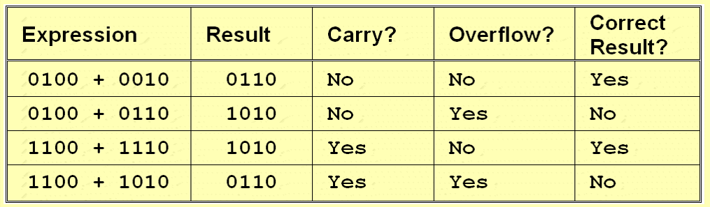
Computers, Arithmetic, and Booth’s Algorithm
Examples of Carry and Overflow in Signed Numbers

Slide 35
Binary Multiplication and Division Using Shifting
We can do binary multiplication and division by 2 very easily using an arithmetic shift operation.
A left arithmetic shift inserts a 0 in for the rightmost bit and shifts everything else left one bit; in effect, it multiplies by 2.
A right arithmetic shift shifts everything one bit to the right, but copies the sign bit; it divides by 2.
Let’s look at some examples.

Slide 36
Binary Multiplication and Division Using Shifting
Example:
Multiply the value 11 (expressed using 8-bit signed two’s complement representation) by 2.
We start with the binary value for 11:
00001011 (+11)
We shift left one place, resulting in:
00010110 (+22)
The sign bit has not changed, so the value is valid.
To multiply 11 by 4, we simply perform a left shift twice.

Slide 37
Binary Multiplication and Division Using Shifting
Example:
Divide the value 12 (expressed using 8-bit signed two’s complement representation) by 2.
We start with the binary value for 12:
00001100 (+12)
We shift left one place, resulting in:
00000110 (+6)
(Remember, we carry the sign bit to the left as we shift.)
To divide 12 by 4, we right shift twice.

Slide 38
Floating-Point Representation
The signed magnitude, one’s complement, and two’s complement representation that we have just presented deal with signed integer values only.
Without modification, these formats are not useful in scientific or business applications that deal with real number values.
Floating-point representation solves this problem.
Fixed point representation is well suited to represent range of positive and negative integers but it has some disadvantages such as
Integers with large magnitude can not be represented
If the division algorithm uses very large dividend and divisor, then the fractional part of the quotient may be lost

Slide 39
Floating-Point Representation
If we are clever programmers, we can perform floating-point calculations using any integer format.
This is called floating-point emulation, because floating point values aren’t stored as such; we just create programs that make it seem as if floating-point values are being used.
Most of today’s computers are equipped with specialized hardware that performs floating-point arithmetic with no special programming required.

Slide 40
Floating-Point Representation
Floating-point numbers allow an arbitrary number of decimal places to the right of the decimal point.
For example: 0.5 × 0.25 = 0.125
They are often expressed in scientific notation.
For example:
0.125 = 1.25 × 10⁻¹
5,000,000 = 5.0 × 10⁶

Slide 41
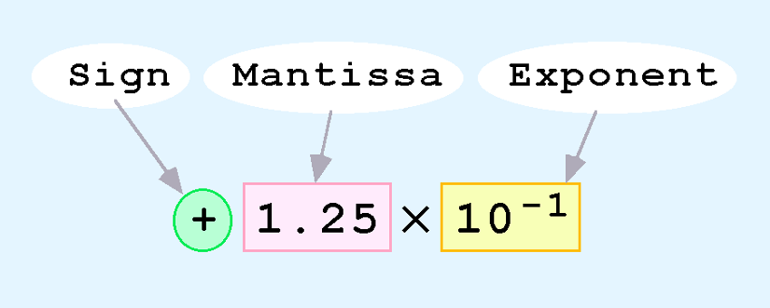
Floating-Point Representation
Computers use a form of scientific notation for floating-point representation
Numbers written in scientific notation have three components:

Slide 42
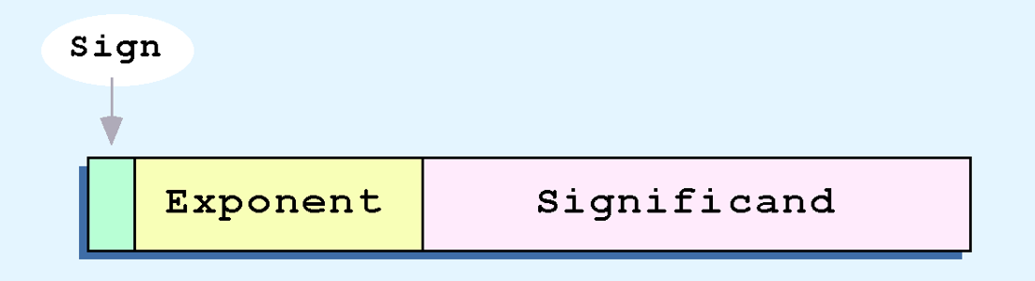
Floating-Point Representation
Computer representation of a floating-point number consists of three fixed-size fields:
This is the standard arrangement of these fields.
Note: Although “significand” and “mantissa” do not technically mean the same thing, many people use these terms interchangeably. We use the term “significand” to refer to the fractional part of a floating point number.

Slide 43

Floating-Point Representation
The one-bit sign field is the sign of the stored value.
The size of the exponent field determines the range of values that can be represented.
The size of the significand determines the precision of the representation.

Slide 44

Floating-Point Representation – A Simple Model
We introduce a hypothetical “Simple Model” to explain the concepts.
In this model:
A floating-point number is 14 bits in length.
The exponent field is 5 bits.
The significand field is 8 bits.
1 bit
5 bits
8 bits

Slide 45
Floating-Point Representation – A Simple Model
The significand is always preceded by an implied binary point.
Thus, the significand always contains a fractional binary value.
The exponent indicates the power of 2 by which the significand is multiplied.
1 bit
5 bits
8 bits

Slide 46
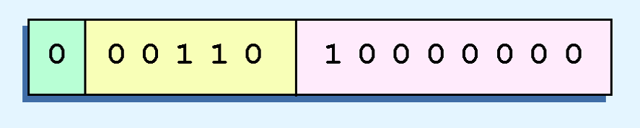
Floating-Point Representation – A Simple Model
Example:
Express 32₁₀ in the simplified 14-bit floating-point model.
We know that 32 is 2⁵. So in (binary) scientific notation 32 = 1.0 x 2⁵ = 0.1 x 2⁶.
In a moment, we’ll explain why we prefer the second notation versus the first.
Using this information, we put 110 (= 6₁₀) in the exponent field and 1 in the significand as shown.
1 bit
5 bits
8 bits

Slide 47
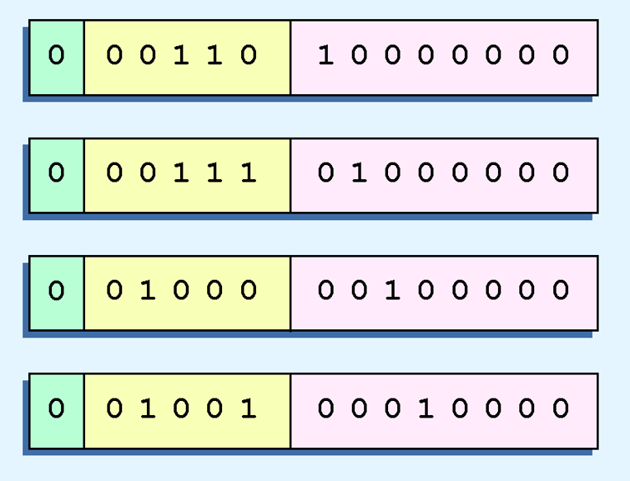
Floating-Point Representation – A Simple Model
The illustrations shown at the right are all equivalent representations for 32 using our simplified model.
Not only do these synonymous representations waste space, but they can also cause confusion.

Slide 48

Floating-Point Representation – A Simple Model
Another problem with our system is that we have made no allowances for negative exponents. We have no way to express 0.5 (= 2⁻¹)! (Notice that there is no sign in the exponent field.)
All of these problems can be fixed with no changes to our basic model.

Slide 49
Floating-Point Representation – A Simple Model
To resolve the problem of synonymous forms, we establish a rule that the first digit of the significand must be 1, with no ones to the left of the radix point.
This process, called normalization, results in a unique pattern for each floating-point number.
In our simple model, all significands must have the form 0.1xxxxxxxx
For example, 4.5 = 100.1 x 2⁰ = 1.001 x 2² = 0.1001 x 2³. The last expression is correctly normalized.
In our simple instructional model, we use no implied bits.

Slide 50
Floating-Point Representation – A Simple Model
To provide for negative exponents, we will use a biased exponent.
In our case, we have a 5-bit exponent.
2⁵⁻¹ – 1 = 2⁴ – 1 = 15
Thus will use 15 for our bias: our exponent will use excess-15 representation.
In our model, exponent values less than 15 are negative, representing fractional numbers.

Slide 51
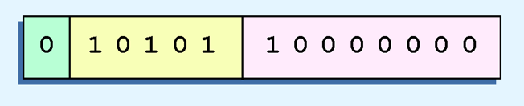
Floating-Point Representation – A Simple Model
Example:
Express 32₁₀ in the revised 14-bit floating-point model.
We know that 32 = 1.0 x 2⁵ = 0.1 x 2⁶.
To use our excess 15 biased exponent, we add 15 to 6, giving 21₁₀ (= 10101₂).
So we have:

Slide 52
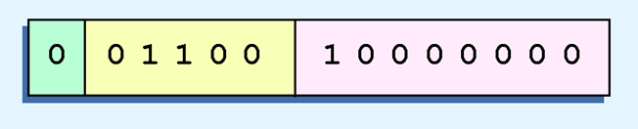
Floating-Point Representation – A Simple Model
Example:
Express 0.0625₁₀ in the revised 14-bit floating-point model.
We know that 0.0625 is 2⁻⁴. So in (binary) scientific notation 0.0625 = 1.0 x 2⁻⁴ = 0.1 x 2⁻³.
To use our excess 15 biased exponent, we add 15 to –3, giving 12₁₀ (= 01100₂).

Slide 53
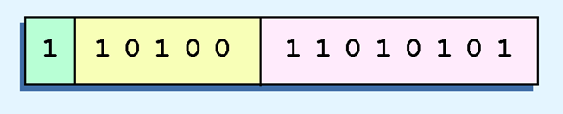
Floating-Point Representation – A Simple Model
Example:
Express –26.625₁₀ in the revised 14-bit floating-point model.
We find 26.625₁₀ = 11010.101₂. Normalizing, we have: 26.625₁₀ = 0.11010101 x 2 ⁵.
To use our excess 15 biased exponent, we add 15 to 5, giving 20₁₀ (= 10100₂). We also need a 1 in the sign bit.

Slide 54
The IEEE-754 Floating-Point Standard
The IEEE has established a standard for floating-point numbers.
The IEEE-754 single precision floating point standard uses an 8-bit exponent (with a bias of 127) and a 23-bit significand.
The IEEE-754 double precision standard uses an 11-bit exponent (with a bias of 1023) and a 52-bit significand.

Slide 55
The IEEE-754 Floating-Point Standard
In both the IEEE single-precision and double-precision floating-point standard, the significant has an implied 1 to the LEFT of the radix point.
The format for a significand using the IEEE format is: 1.xxx…
For example, 4.5 = .1001 x 2³ in IEEE format is: 4.5 = 1.001 x 2². The 1 is implied, which means is does not need to be listed in the significand (the significand would include only 001).

Slide 56
The IEEE-754 Floating-Point Standard
Example: Express –3.75 as a floating-point number using IEEE single precision.
First, let’s normalize according to IEEE rules:
3.75 = –11.11₂ = –1.111 x 2¹
The bias is 127, so we add 127 + 1 = 128 (this is our exponent)
The first 1 in the significand is implied, so we have:
Since we have an implied 1 in the significand, this equates to
–(1).111₂ x 2 ^{(128 – 127)} = –1.111₂ x 2¹ = –11.11₂ = –3.75.

Slide 57
The IEEE-754 Floating-Point Standard
Using the IEEE-754 single precision floating point standard:
An exponent of 255 indicates a special value.
If the significand is zero, the value is ± infinity.
If the significand is nonzero, the value is NaN, “not a number,” often used to flag an error condition.
Using the double precision standard:
The “special” exponent value for a double precision number is 2047, instead of the 255 used by the single precision standard.

Slide 58
The IEEE-754 Floating-Point Standard
Both the 14-bit model that we have presented and the IEEE-754 floating point standard allow two representations for zero.
Zero is indicated by all zeros in the exponent and the significand, but the sign bit can be either 0 or 1.
This is why programmers should avoid testing a floating-point value for equality to zero.
Negative zero does not equal positive zero.

Slide 59
Floating-Point Arithmetic
Floating-point addition and subtraction are done using methods analogous to how we perform calculations using pencil and paper.
The first thing that we do is express both operands in the same exponential power, then add the numbers, preserving the exponent in the sum.
If the exponent requires adjustment, we do so at the end of the calculation.

Slide 60
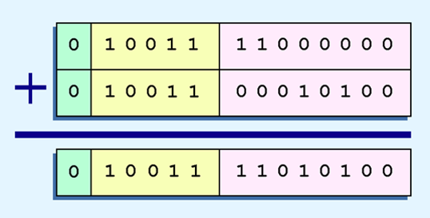
Floating-Point Arithmetic
Example:
Find the sum of 12₁₀ and 1.25₁₀ using the 14-bit “simple” floating-point model.
We find 12₁₀ = 0.1100 x 2⁴. And 1.25₁₀ = 0.101 x 2¹ = 0.000101 x 2⁴.
Thus, our sum is 0.110101 x 24.

Slide 61
Floating-Point Arithmetic
Floating-point multiplication is also carried out in a manner akin to how we perform multiplication using pencil and paper.
We multiply the two operands and add their exponents.
If the exponent requires adjustment, we do so at the end of the calculation.

Slide 62
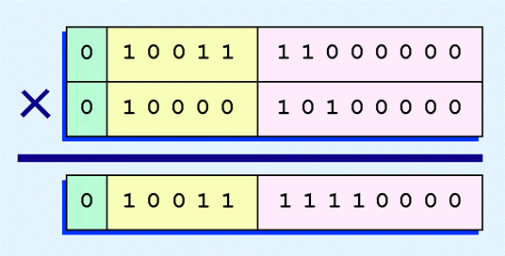
Floating-Point Arithmetic
Example:
Find the product of 12₁₀ and 1.25₁₀ using the 14-bit floating-point model.
We find 12₁₀ = 0.1100 x 2 ⁴. And 1.25₁₀ = 0.101 x 2¹.
Thus, our product is 0.0111100 x 25 = 0.1111 x 24.
The normalized product requires an exponent of 19₁₀ = 10011₂.

Slide 63
Floating-Point Representation – Range, Precision, and Accuracy
When discussing floating-point numbers, it is important to understand the terms range, precision, and accuracy.
The range of a numeric integer format is the difference between the largest and smallest values that can be expressed.
Accuracy refers to how closely a numeric representation approximates a true value.
The precision of a number indicates how much information we have about a value.

Slide 64
Floating-Point Representation – Range, Precision, and Accuracy
Most of the time, greater precision leads to better accuracy, but this is not always true.
For example: 3.1333 is a value of pi that is accurate to two digits, but has 5 digits of precision.
There are other problems with floating point numbers.
Because of truncated bits, you cannot always assume that a particular floating point operation is commutative or distributive.

Slide 65
Floating-Point Representation – Range, Precision, and Accuracy
This means that we cannot assume:
(a + b) + c = a + (b + c) or
a*(b + c) = ab + ac
Moreover, to test a floating point value for equality to some other number, it is best to declare a “nearness to x” epsilon value. For example, instead of checking to see if floating point x is equal to 2 as follows:
if x = 2 then …
it is better to use:
if (abs(x - 2) < epsilon) then ...
(assuming we have epsilon defined correctly!)

Slide 66
Character Codes
Calculations aren’t useful until their results can be displayed in a manner that is meaningful to people.
We also need to store the results of calculations, and provide a means for data input.
Thus, human-understandable characters must be converted to computer-understandable bit patterns using some sort of character encoding scheme.

Slide 67
Character Codes
As computers have evolved, character codes have evolved.
Larger computer memories and storage devices permit richer character codes.
The earliest computer coding systems used six bits.
Binary-coded decimal (BCD) was one of these early codes. It was used by IBM mainframes in the 1950s and 1960s.

Slide 68
Character Codes
In 1964, BCD was extended to an 8-bit code, Extended Binary-Coded Decimal Interchange Code (EBCDIC).
EBCDIC was one of the first widely-used computer codes that supported upper and lowercase alphabetic characters, in addition to special characters, such as punctuation and control characters.
EBCDIC and BCD are still in use by IBM mainframes today.

Slide 69
Character Codes
Other computer manufacturers chose the 7-bit ASCII (American Standard Code for Information Interchange) as a replacement for 6-bit codes.
While BCD and EBCDIC were based upon punched card codes, ASCII was based upon telecommunications (Telex) codes.
Until recently, ASCII was the dominant character code outside the IBM mainframe world.

Slide 70
Character Codes
Many of today’s systems embrace Unicode, a 16-bit system that can encode the characters of every language in the world.
The Java programming language, and some operating systems now use Unicode as their default character code.
The Unicode codespace is divided into six parts. The first part is for Western alphabet codes, including English, Greek, and Russian.

Slide 71
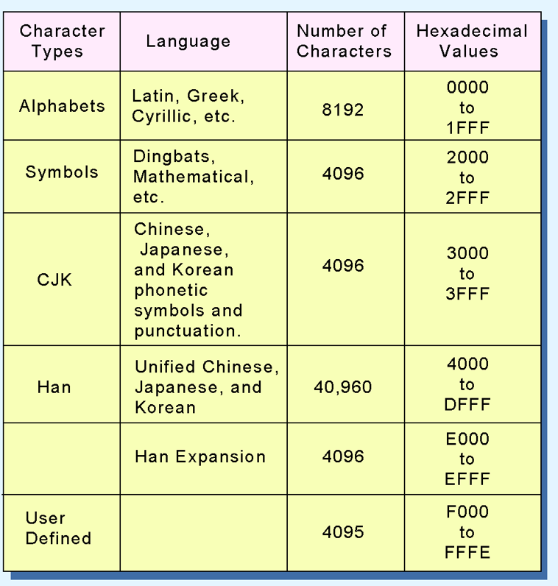
Character Codes
The Unicode codespace allocation is shown at the right.
The lowest-numbered Unicode characters comprise the ASCII code.
The highest provide for user-defined codes.

Slide 72
Conclusion
Computers store data in the form of bits, bytes, and words using the binary numbering system.
Hexadecimal numbers are formed using four-bit groups called nibbles.
Signed integers can be stored in one’s complement, two’s complement, or signed magnitude representation.
Floating-point numbers are usually coded using the IEEE 754 floating-point standard.
Character data is stored using ASCII, EBCDIC, or Unicode.

Slide 73

kent.edu.au Kent Institute Australia Pty. Ltd. ABN 49 003 577 302 ● CRICOS Code: 00161E ● RTO Code: 90458 ● TEQSA Provider Number: PRV12051

